Slide 1
SC Bar Convention 2025 Running for a Judgeship in SC
Erin B. Crawford, Chief Counsel
Kate Crater, House Counsel
Judicial Merit Selection Commission

Slide 2
How Does SC Elect Judges?
Only SC and VA use a system of merit selection and legislative election.
Other state judicial selections fall into 4 categories:
Legislative Appointment
Gubernatorial Appointment
Direct Election (Partisan and Non-Partisan)
Merit Selection

Slide 3
What is the Judicial Merit Selection Commission? What role does it play in the election of judges in South Carolina?

Slide 4
S. 1046, Act No. 219, 2024 Out with the old, in with the new
Signed by the Governor on July 2, 2024, with an effective date of July 1, 2025
Some changes:
changes the composition of the commission
increases the number of candidates nominated by the commission
alters the election timelines
adds to the candidate disclosure requirements
requires the livestreaming of hearings
changes withdrawal procedure
adds midterm evaluations of judges

Slide 5
JMSC Composition: 12 members appointed
SC Senate: 4
SC House: 4
Governor: 4
President of the Senate must appoint 1 Senator, and 1 member of the South Carolina Bar in good standing with 10 years’ experience
Chairman of Judiciary must appoint 2 Senators
3 must be House of Representatives members
1 must be a member of the South Carolina Bar in good standing with 10 years’ experience
All appointments by the Speaker
All must be members in good standing of the South Carolina Bar with at least 10 years’ experience

Slide 6
The JMSC screens all judges for the following:
Supreme Court
Court of Appeals
Circuit Court
Family Court
Administrative Law Court
Master-In-Equity

Slide 7
“Screening” involves conducting a thorough evaluation of each candidate’s qualifications, including a review of the candidate’s professional and personal life.
Screening

Slide 8
Statutory & Constitutional Requirements for JMSC Candidates
All of the candidates, no matter what judicial office sought, must be:
a citizen of the United States and of SC;
at least 32 years of age;
a licensed attorney at law for at least 8 years;
a resident of South Carolina for 5 years preceding his/her election.

Slide 9
What evaluative criteria must each judicial candidate meet?
1) constitutional qualifications;
2) ethical fitness;
3) professional & academic ability;
4) character;
5) reputation;
6) physical health;
7) mental stability;
8) experience; and
9) judicial temperament.

Slide 10
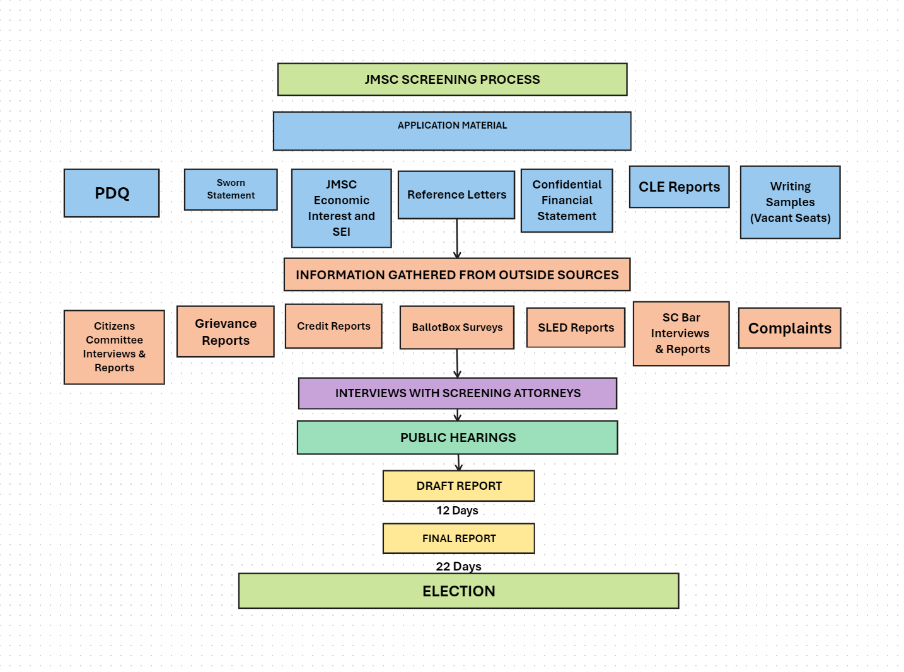

Slide 11
Application Materials
The candidate submits a minimum of 8 application documents, to include a personal data questionnaire (PDQ), a Sworn Statement, a JMSC Economic Interest Form, a State Ethics Commission Form (SEI), a Confidential Financial Statement, 5 letters of recommendation, CLE reports for the past 5 years, and writing samples if seeking an open seat.
The application documents must be turned in no later than a published deadline for the applicant to be considered a judicial candidate.

Slide 12
Materials Gathered from Outside Sources: Citizens Committee Reports Grievance Reports Credit Reports BallotBox Survey Results SLED Reports SC Bar Reports Complaints

Slide 13
Citizens Committee Reports
The Chairman of JMSC, upon the advice of the commission, selects members to serve on Citizens Committees on Judicial Qualifications.
There are five Citizens Committees in the state. The Committees are comprised of up to 10 members from the Pee Dee, Lowcountry, Upstate, Piedmont, and Midlands regions.
The Committees “research” and interview the candidates before issuing reports for each candidate based on the 9 evaluative criteria.
The screening attorneys and JMSC members receive reports from each Committee, and those reports are made a part of the public record at the public hearing.

Slide 14
SC Bar Reports
The candidates are “researched” and interviewed by the SC Bar’s Judicial Qualifications Committee.
The SC Bar has specific criteria that they attempt to meet as they research each candidate. For example, at least 30 phone calls are made on each candidate during the investigation.
The SC Bar asks questions about substantive areas of law and background information during the interview.
The SC Bar issues reports for each candidate based on the 9 evaluative criteria.
The screening attorneys and JMSC members receive the SC Bar reports and those reports are made part of the public record at the public hearing.

Slide 15
Grievance Reports
JMSC receives letters from the Commission on Lawyer Conduct and the Commission on Judicial Conduct stating whether there is a record of public discipline from the Supreme Court in the area of misconduct.
Under the new legislation, candidates must also disclose on their PDQ any sanctions, including private reprimands. Private reprimands, such as letters of caution, would be redacted from the PDQ prior to being entered into the public record; however, they are subject to discussion by the JMSC in executive session.

Slide 16
BallotBox Surveys
All active members of the South Carolina Bar and Clerks of Court are sent a survey on which to report on the evaluative criteria of the candidates.
The surveys are anonymous, and responses are confidential.
Candidates may receive the percentages of each evaluative criteria, but they may not receive copies of the comments.
A recurrent theme (whether positive or negative) can carry a lot of weight with the JMSC.

Slide 17
Midterm Reviews
The new legislation requires midterm reviews of sitting justices and judges.
The Bar will conduct midterm reviews utilizing electronic BallotBox survey polling (or another form of electronic survey).
The results of the midterm reviews will be forwarded to the Chief Justice and then provided to the Commission at the next public screening of the judicial candidate.

Slide 18
SLED & Credit Reports
SLED Reports
SLED conducts a thorough investigation and background check on each candidate and issues a report to the commission.
Credit Reports
The Senate Clerk’s office runs a credit report for each candidate. This report is added to the candidate’s financial file. Staff compares it to the submitted confidential financial statement.

Slide 19
Complaints
If a person wishes to file a complaint and testify concerning a judicial candidate at the public hearing, he/she must submit an affidavit of complaint form with supporting documentation, in person or by mail, by a strict deadline.
For the complaint to be accepted by the Commission, it must state allegations relating to the candidate’s character, competency, or ethics. All allegations raised in the complaint must be based on the complainant’s personal knowledge.

Slide 20
Screening Attorney Interviews
Using the application documents, information received from outside sources, and staff’s investigation, screening attorneys conduct interviews with assigned candidates.
The screening attorneys provide pertinent information on each candidate to the Commission in preparation for the public hearing.
The screening attorneys prepare the judicial candidates for the public hearing.

Slide 21
Public Hearing
The candidates appear before the 12 members of the JMSC at the public hearing.
Any complaints are heard.
After some housekeeping questions by the screening attorney, the members of the JMSC can ask the candidates about any positive or negative themes uncovered during the screening process.
The public hearing will be live streamed.
If the JMSC members want to ask a question on a private matter, such as the financial records of the candidate, the JMSC can go into executive session where the public is escorted out of the room. Executive session will not be live streamed.

Slide 22
Public Hearing
IN THE PAST:
Candidates could withdraw their name from consideration at any time.
The JMSC voted and could find 3 candidates qualified and nominated for each seat.
NOW:
Candidates can withdraw only before the public hearing or after the issuance of the draft report.
The JMSC votes and can find up to 6 candidates qualified and nominated for each seat.

Slide 23
Formal Release of the Report on Qualifications
No member of the General Assembly may offer a pledge (and no candidate may seek a pledge) until the qualifications of all candidates for that office have been determined by the JMSC and the JMSC has formally released its Report on Judicial Qualifications.
Previously: the formal release of the report occurred no earlier than 48 hours after a draft report was issued.
Now: a formal release of the report occurs no earlier than 12 days after the draft report is issued.

Slide 24
Pledging and Vote Counting
Before the formal release of the report, no person may:
Seek, directly or indirectly, the pledge of a General Assembly member’s vote.
Contact a member of the General Assembly regarding screening for the judicial office.
Request that a member of the General Assembly act on behalf of a candidate “in furtherance of the candidate’s candidacy,” including vote counting.

Slide 25
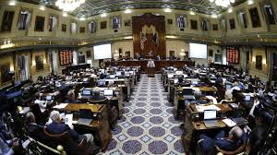
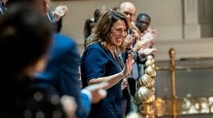
Legislative Election
New in this legislation, the election will be held at least 22 days after the issuance of the report.
Joint Election of both bodies is held in the House of Representatives.
Generally, the House votes electronically, and the Senate requires a voice vote of each member.
Necessary vote to win: majority of those present and voting.

Slide 26
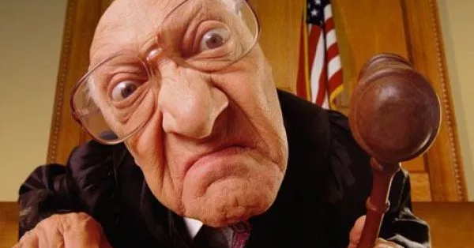
Common issues

Slide 27
Character

Slide 28
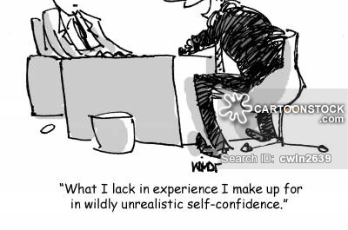
Experience

Slide 29
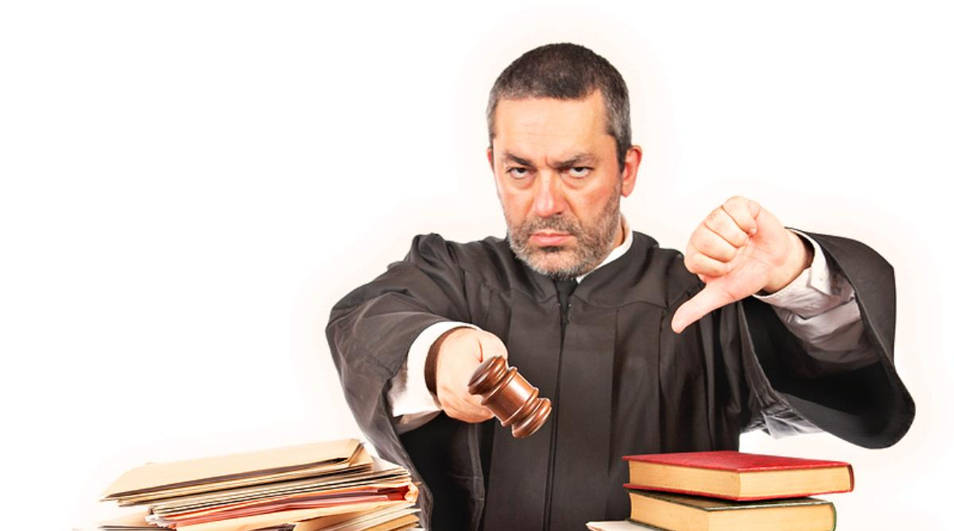
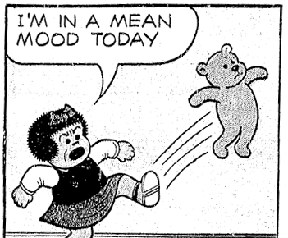
Judicial Temperament

Slide 30
Where Can You Learn and See More About Judicial Elections in SC?
Visit the website for the South Carolina Legislature at www.scstatehouse.gov.
Click on the Citizens’ Interest tab at the top of the page.
Click on the link for the Judicial Merit Selection Commission.
There, you will find links to all of the judicial elections, the public documents, and all of the laws that govern the election of judges in SC.

Slide 31
Any Questions? Please feel free to contact us!
Chief Counsel
Counsel
Erin B. Crawford
erincrawford@scsenate.gov
(803) 212-6689
Kate Crater
katecrater@schouse.gov
(803) 734-3120

